Slide 1
Functional Genomics Practical
Mohammad Rezaei| 18 November 2025

Slide 2
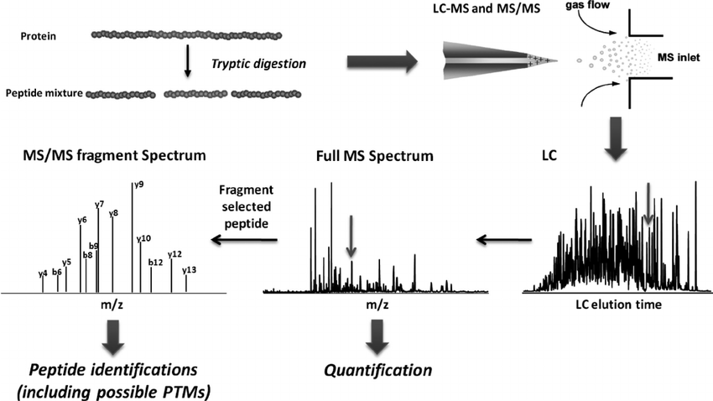
Proteomics Work Flow
DOI: 10.1074/jbc.R110.199703

Slide 3
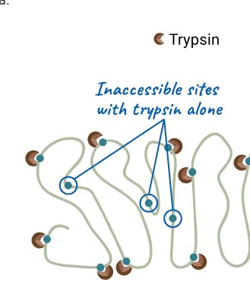
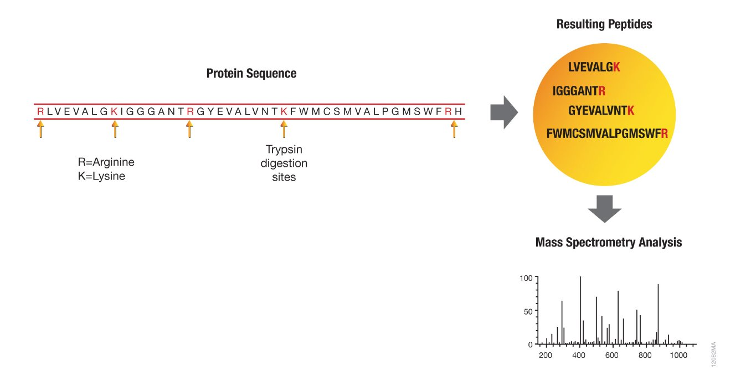
From theoretical peptides to real sample digest
The “theoretical digest” means: for a given protein sequence, apply enzyme rules
(e.g. trypsin always cuts after K/R) → list of all possible peptides.
https://www.promega.de/en/resources/guides/protein-analysis/protease-digestion-for-mass-spec/
DOI: 10.1074/jbc.R110.199703

Slide 4
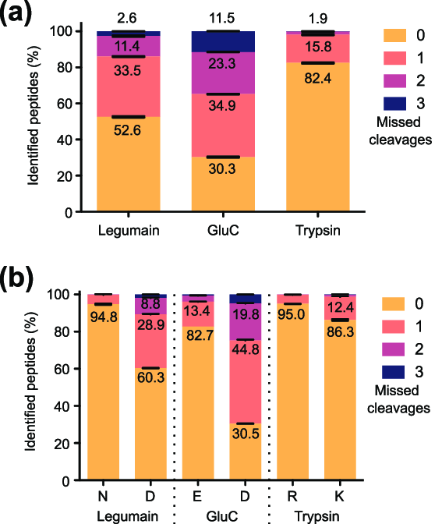
From theoretical peptides to real sample digest
In reality: protein extraction → denaturation → digestion → cleanup → LC-MS/MS. At each step peptides may be lost or transformed.
So we should expect:
Maximum theoretical peptides ≥ actual peptides detected.
DOI: 10.1021/acs.analchem.9b03604

Slide 5
Why many peptides don’t show up: key limiting factors
Digestion inefficiencies: e.g. missed cleavages, blocked/modified sites, protein structure impeding enzyme access → fewer “ideal” peptides.
Peptides with unsuitable properties: too small/too large, extreme hydrophobicity, weak ionisation → poor LC/MS detection.
Sample & LC losses: adsorption to tubes or tips, co-elution suppression, low abundance overshadowed by high abundance peptides.
Acquisition & selection issues: in DDA (data dependent acquisition) the instrument selects only top N-ions → many lower-abundance peptides never get fragmented.
Data analysis filters: some peptides are present but the MS/MS spectra are of poor quality, or search parameters too strict → they go undetected or unassigned. Systematic errors arise from e.g. modifications, shared peptides, etc.
https://egor-pro.medium.com/missing-with-out-a-trace-da186405e02b

Slide 6
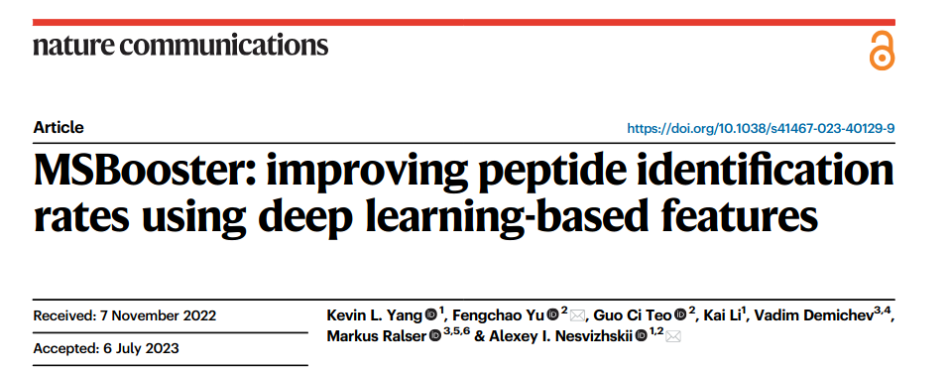
Consequences & mitigation strategies
Consequences: lower proteome/peptide coverage than predicted; gaps (“missing values”) in quantitative datasets; bias toward high‐abundance peptides; under-representation of low abundance or difficult peptides (e.g., from membrane proteins, PTMs)
Mitigation strategies:
Improve digestion efficiency (optimize enzyme:substrate ratio, denaturation, time, etc).
Use alternative proteases or multi-enzyme digestions to cover “hard” regions.
Choose acquisition mode carefully: consider DIA (data independent acquisition) to reduce stochastic missing values compared to DDA.
https://doi.org/10.1038/s41467-023-40129-9

Slide 7
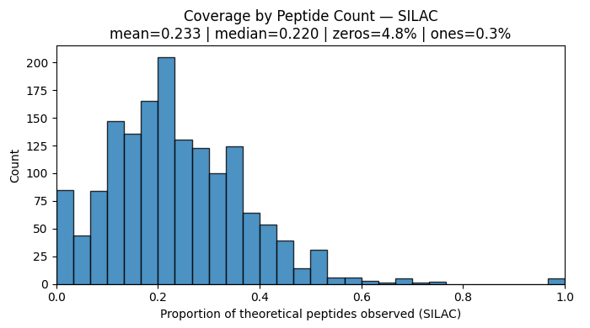
Sample Statistics

Slide 8
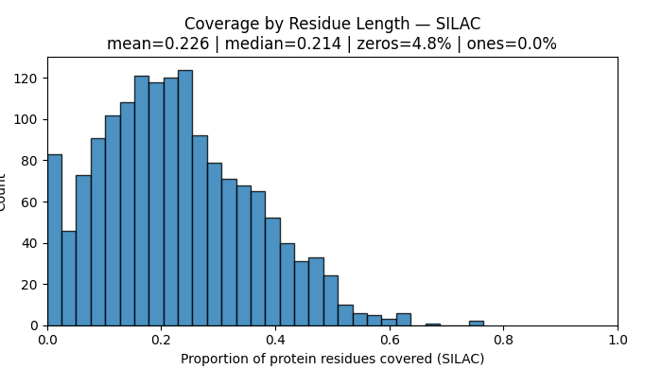
Sample Statistics

Slide 9
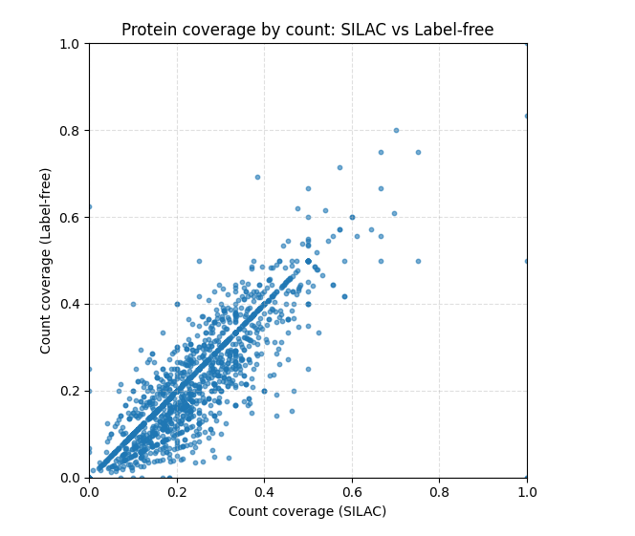
Sample Statistics

Slide 10
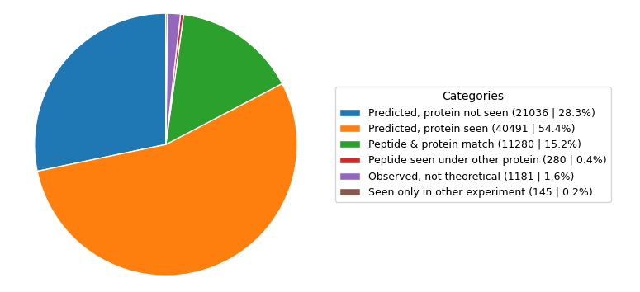
Sample Statistics

Slide 11
Training ML Models
LogisticRegression | Accuracy: 0.820 | F1: 0.617
RandomForest | Accuracy: 0.869 | F1: 0.731
XGBoost | Accuracy: 0.881 | F1: 0.764
SVM | Accuracy: 0.859 | F1: 0.710
MLP | Accuracy: 0.847 | F1: 0.700
ESM2 Fine tuning | Accuracy: 0.887 | F1: 0.888

Slide 12
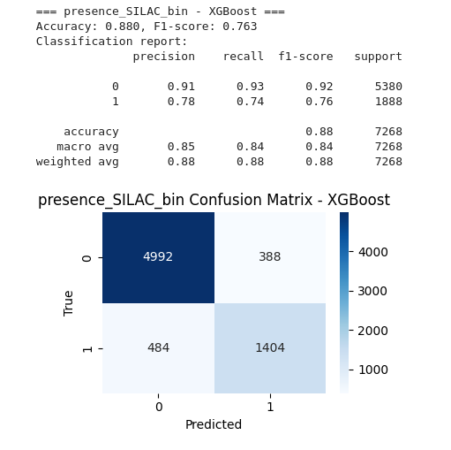
Training ML Models

Slide 13
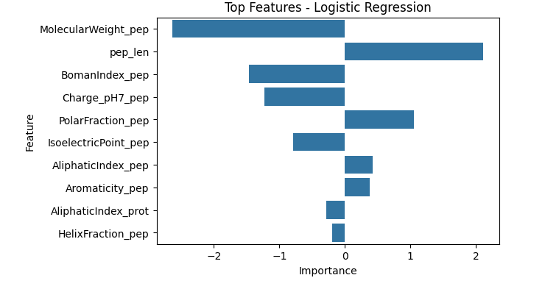
ML Interpretability

Slide 14
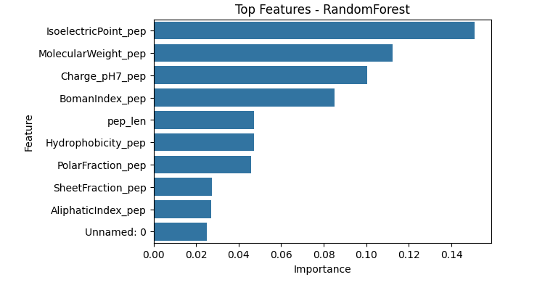
ML Interpretability

Slide 15
ML Interpretability

Slide 16
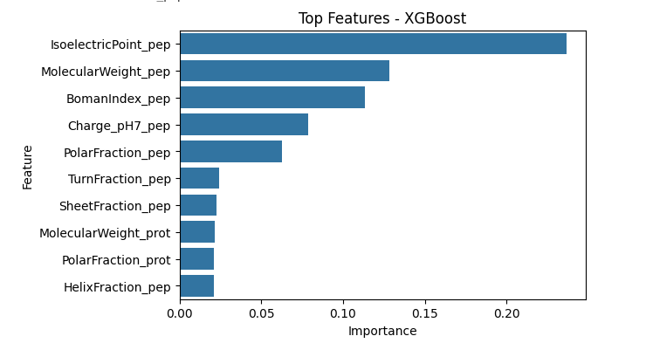
ML Interpretability

Slide 17
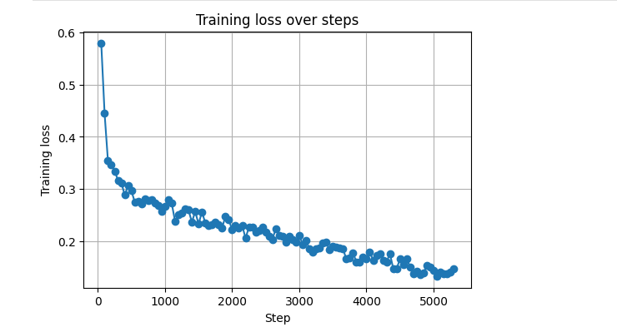
Deep Learning Models : Experiment with ESM 2
DOI: 10.1126/science.ade2574

Slide 18
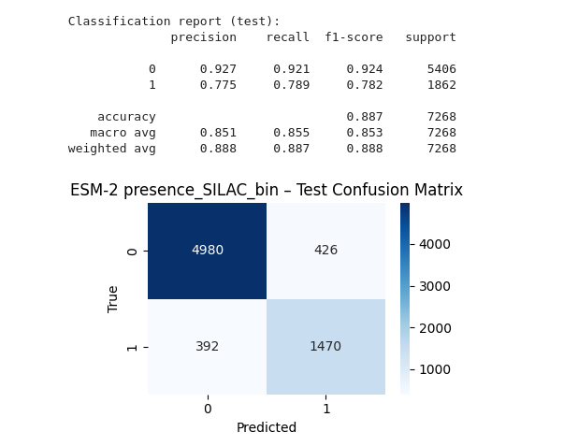
Deep Learning Models : Experiment with ESM 2

Slide 19
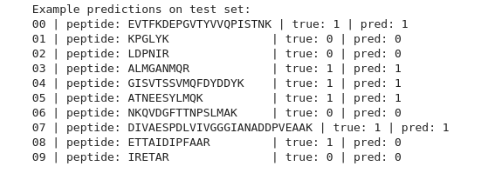
Deep Learning Models : Experiment with ESM 2

Slide 20
Practical Outline
1. First iteration: EDA + initial ML training ✅ (completed)
What was done
Performed exploratory data analysis (EDA) on the available samples.
Trained several baseline ML models (e.g. regression/ RF/ SVM/ XGBoost/ models) to predict the target.
Main outcomes
Identified which models perform reasonably well.
Identified key challenges:
  Limited sample size → risk of overfitting
  Reproducibility of results

Slide 21
Practical Outline
2. Experiment with digestion metrics & integrate into pipeline ⏳ ~2 days
Goal
Design and test digestion-related parameters
Integrated End-To-End pipeline
Planned work
Integrate these metrics into preprocessing & feature engineering steps.
See how digestion parameters affects the predictions

Slide 22
Practical Outline
3. Comprehensive data analysis + full training on all samples ⏳ ~1 week (approx.)
Goal
Move from “prototype” to complete analysis using all available samples and the improved feature set.
Planned work
Full, cleaned EDA on the entire dataset
Evaluate performance using solid metrics ( AUC, F1 ).
Perform error analysis: which types of peptides/samples are systematically mis-predicted?
Expected result
A robust, documented pipeline from raw features → digestion metrics → model → performance.
Clear understanding of limitations and strengths of the approach.

Slide 23
Practical Outline
4. Final report, findings, and literature-based suggestions ⏳ ~1 week
Goal
Summarize all practical work and link it to a report.
Provide recommendations for improving peptide detection and experimental design.
Planned work
Write final report including:
Introduction & background, Methods, Results, and Discussion.

Slide 24
Sugesstions

